Slide 1
OOP Project
On data processing and data visualization

Slide 2

Netflix Exploratory Data Analysis (EDA)
This Photo by Unknown Author is licensed under CC BY-SA

Slide 3
Netflix EDA description:-
An EDA is a data processing and visualization project which helps in gaining valuable insights from a dataset.
We will be using a dataset from Kaggle of movies and TV shows on the Netflix streaming platform.
Our EDA consists of bar charts, scatter plots, pie charts and other data visualization techniques which are used on processed data to deliver valuable insights.

Slide 4


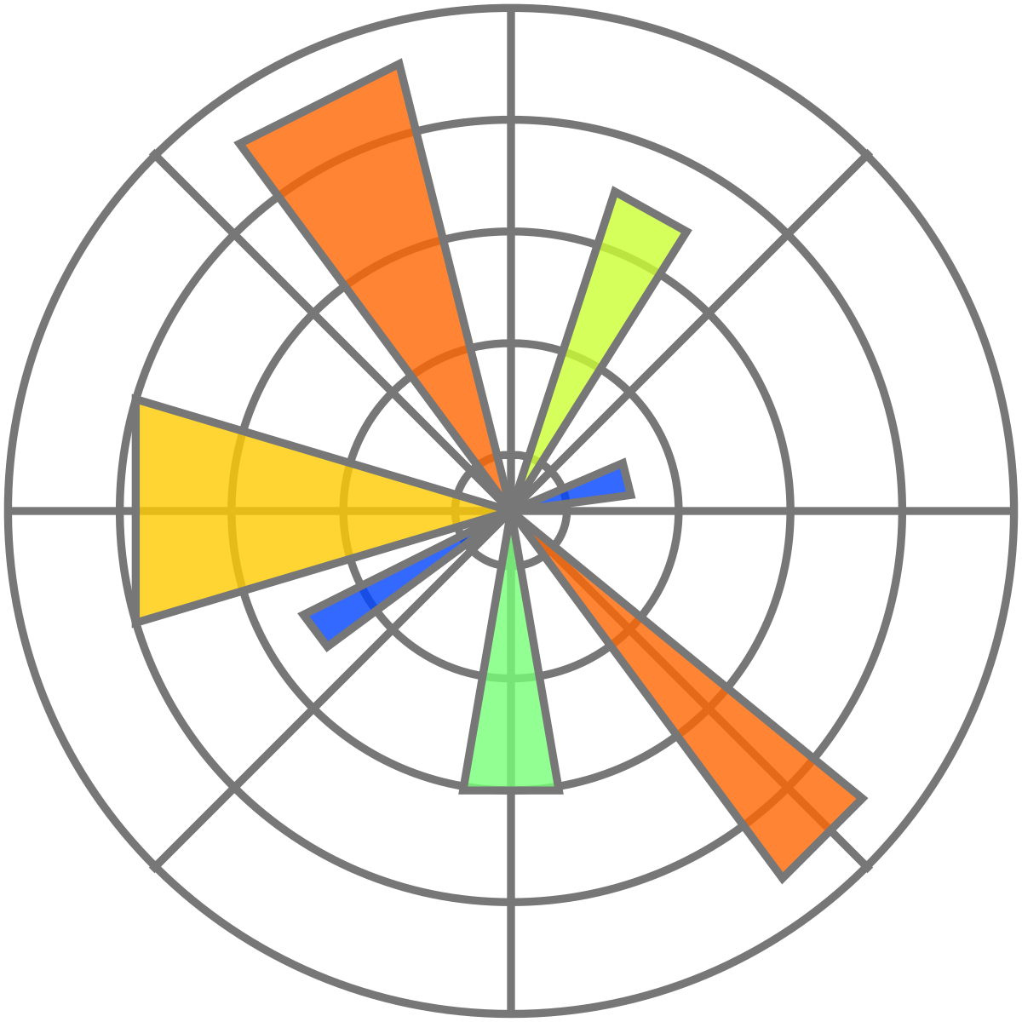
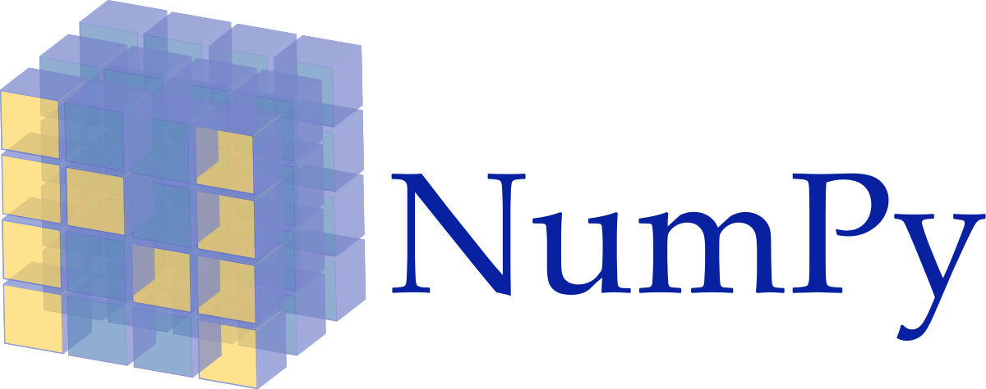
Tech Stack used:-

Slide 5
Project Timeline
Training and practice
Groundwork
(Setting up the notebook environment)
Deciding the storyline
Coding the data processing and data visualizations
Making the project architecture
(UML class diagram)
Project report and documentation.

Slide 6
Names of Contributors to the project:-
Aakash Chaurasia (20BCS001)
Abhishekh Dubey (20BCS002)
Aditya Tiwari (20BCS007)
Devansh Mahant (20BCS039)
Kartik Bhamare (20BCS066)
Prithviraj Kamble (20BCS104)
Mahendra Poonia (20BCS082)
Tushar Dhotre (20BCS042)

